Slide 1

2019 Airbnb New York Dataset
Ryan Meston Bellevue University

Slide 2
Abstract & Project Questions
The goal of this project is to explore the 2019 New York Airbnb dataset to see why rental prices are set how they are. The questions I want to answer with this project are:
Which hosts are the busiest and why?
How much money do hosts make per year that have more than 50 properties?
Are there any relationships between prices based on the neighborhood the rental unit is in?
Are the units cheaper than hotel rooms in the area?
Are the busiest locations around tourist hotspots or are they by large corporations?

Slide 3
Introduction and Background
The dataset I used for this project was found on Kaggle.com. This dataset houses all of New York’s 2019 Airbnb data. The row headings for the dataset are as follows:
id - Shows a number instead of a name of the client who used Airbnb’s service.
name - Brief description of the rental property.
host_id - Shows a number that correlates with the host_name.
host_name - Name of the host or company that is renting out the property.
neighbourhood_group - Showing the large neighborhood, the rental property is in.
neighbourhood - A more detailed name of the neighborhood that the rental property is in.

Slide 4
Introduction and Background Continued
latitude - Latitude coordinate of the rental property.
longitude - Longitude coordinate of the rental property.
room_type - Showing whether the room is a home/apartment/private room.
price - Showing the price of the rental property.
minimum_nights - Showing the minimum number of nights stayed at the rental property.
number_of_reviews - Showing the number of reviews of the rental property.
last_review - Showing the date of the last review of the rental property.
reviews_per_month - Showing how many reviews per month the rental property receives.
calculated_host_listings_count - Showing the number of rental properties, the host_id has.
availability_365 - Showing how many days a year, the rental property is available.

Slide 5
Methodology
------------2019 New York Airbnb Data-----------
Total Dollars from Rental Properties: $7,467,278.
Total Nights Units were Stayed in: 343,730.
Total Number of Reviews: 1,138,005
Total Reviews per Month: 53,340.
----------Statistical Summary----------
The average price per rental unit is: $152.72.
The minimum price per rental unit is: $0.00.
The maximum price per rental unit is: $10,000.00.
The standard price per rental unit is: $240.15.

Slide 6
2019 Sonder Data
----------------2019 Sonder Data---------------
Total Dollars from Rental Properties: $82,795.
Total Nights Units were Stayed in: 4,353.
Total Number of Reviews: 1,281.
Total Reviews per Month: 397.
327 Rental Properties

Slide 7
2019 Blueground Data
----------------2019 Blueground Data---------------
Total Dollars from Rental Properties: $70,331.
Total Nights Units were Stayed in: 7,470.
Total Number of Reviews: 29.
Total Reviews per Month: 6.
232 Rental Properties

Slide 8
2019 Kara Data
----------------2019 Kara Data---------------
Total Dollars from Rental Properties: $33,581.
Total Nights Units were Stayed in: 3,767.
Total Number of Reviews: 65.
Total Reviews per Month: 3.
121 Rental Properties

Slide 9
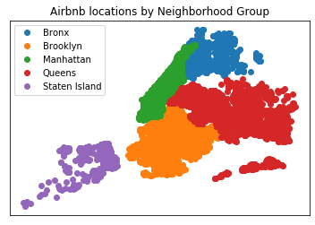

Slide 10
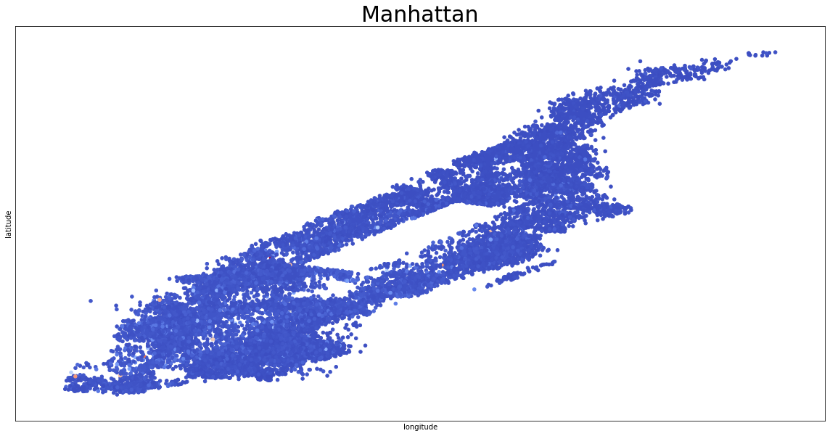
Manhattan Data

Slide 11
Manhattan Data Continued
----------------2019 Manhattan Data---------------
Total Dollars from Rental Properties: $4,264,527.
Total Nights Units were Stayed in: 185,833.
Total Number of Reviews: 454,569.
Total Reviews per Month: 21,158.
Average price per night: $196.
Maximum price per night: $10,000.

Slide 12
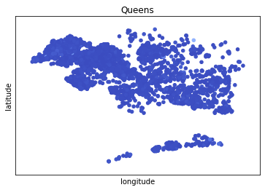
Queens Data
------------2019 Queens Data-----------
Total Dollars from Rental Properties: $563,867.
Total Nights Units were Stayed in: 29,358.
Total Number of Reviews: 156,950.
Total Reviews per Month: 8,879.
Average price per night: $99.
Maximum price per night: $10,000.

Slide 13
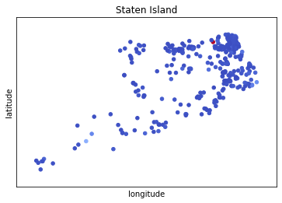
Staten Island Data
-------2019 Staten Island Data------
Total Dollars from Rental Properties: $42,825.
Total Nights Units were Stayed in: 1,802.
Total Number of Reviews: 11,541.
Total Reviews per Month: 587.
Average price per night: $114.
Maximum price per night: $5,000.

Slide 14
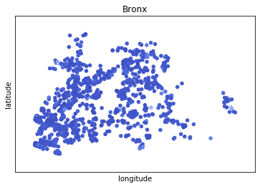
Bronx Data
--------------2019 Bronx Data-------------
Total Dollars from Rental Properties: $95,459.
Total Nights Units were Stayed in: 4,976.
Total Number of Reviews: 28,371.
Total Reviews per Month: 1,609.
Average price per night: $87.
Maximum price per night: $2,500.

Slide 15
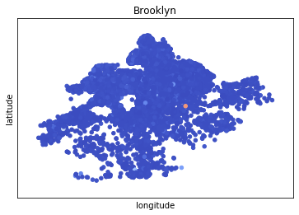
Brooklyn Data
------------2019 Brooklyn Data-----------
Total Dollars from Rental Properties: $2,500,600.
Total Nights Units were Stayed in: 121,761.
Total Number of Reviews: 486,574.
Total Reviews per Month: 21,104.
Average price per night: $124.
Maximum price per night: $10,000.

Slide 16
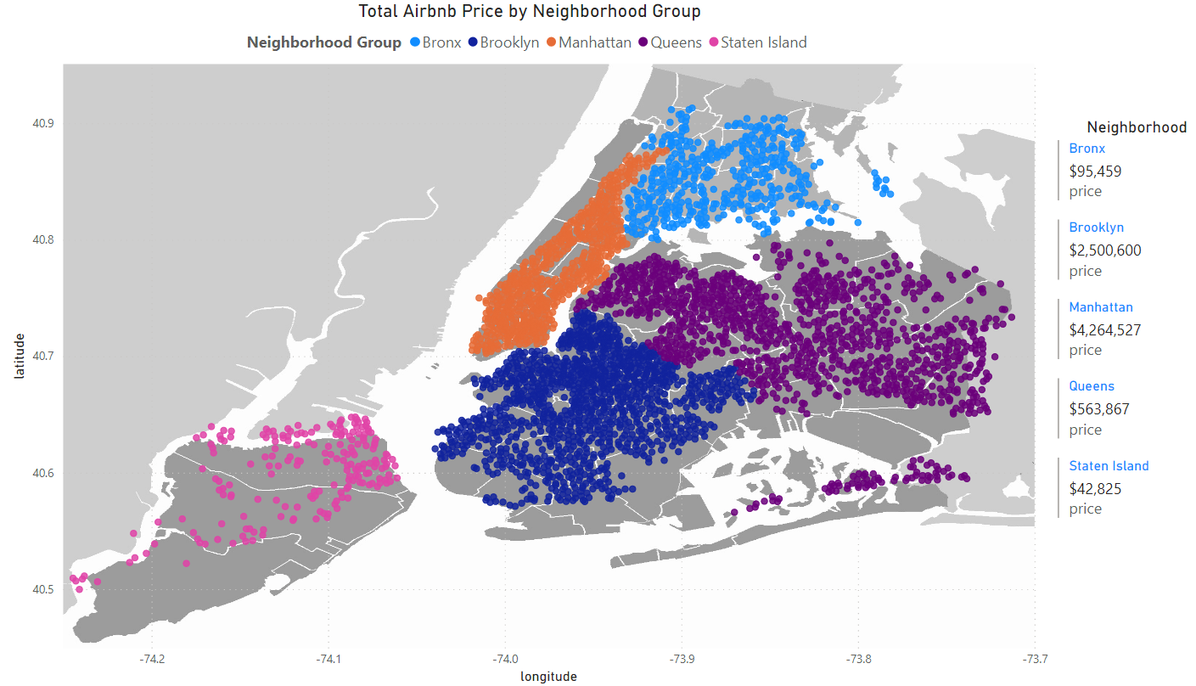

Slide 17
Results
Which hosts are the busiest and why?
This question is answered with the three busiest host.
How much money do hosts make per year that have more than 50 properties?
This question is now how much money the top three hosts make per year with more than 50 rental properties.
Are there any relationships between prices based on the neighborhood the rental unit is in?
Are the units cheaper than hotel rooms in the area?
Are the busiest locations around tourist hotspots or are they buy large corporations?

Slide 18
10 Questions
How many companies utilize Airbnb’s platform to rent properties in cities?
How many different cities are currently utilizing Airbnb’s platform?
What is Airbnb’s platform like on a world scale?
Does Airbnb charge companies the use their platform a fee?
How can we predict future dollars on rental properties based off a previous year’s numbers?
How many rental properties are second homes?
Can you tell the success of an area based off rental property reviews?
What is the outlook of rental properties after Covid 19?
How will Airbnb and other companies get people attracted to Covid hotspot cities for vacation?
How long will it take for rental properties and companies to recover from the Covid 19 pandemic?

